Slide 1

DATA CATALYST CONSULTING
Catalyzing Growth through Data

Slide 2
Methodologies Used:
KNN Clustering – Customer Segmentation
Feature Selection and Scaling: Used salary and spending score as features. Scaled data for unbiased clustering.
Optimal Clusters: Employed elbow method to find optimal number of clusters (4) for meaningful customer segments.
2. Apriori – Product Recommendation
Support and Confidence: Carefully set support and confidence thresholds to identify frequent product combinations and strong associations.
Rule Evaluation: Generated rules like "If Product A, then likely Product B." Evaluated rules using support, confidence, lift metrics for actionable recommendations.

Slide 3
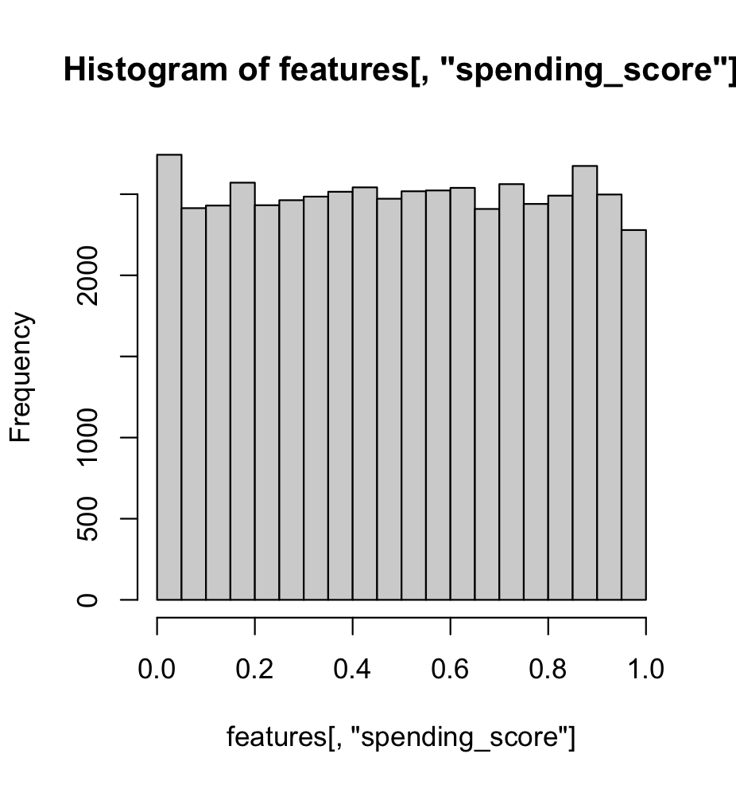
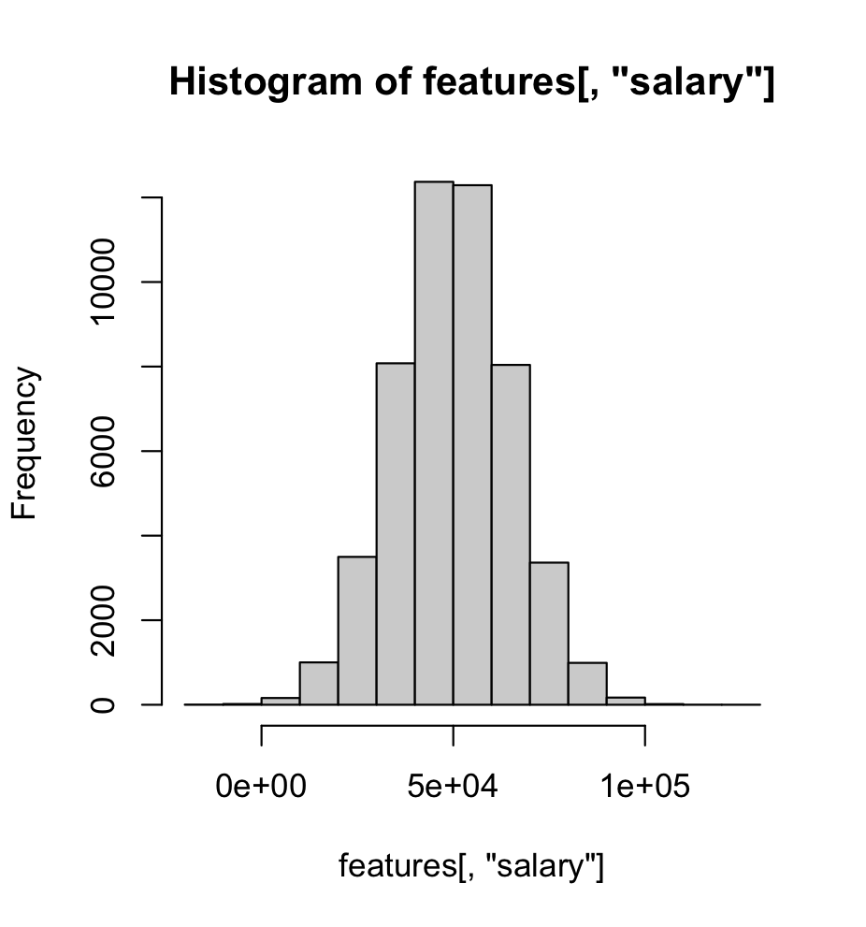
Visualizations

Slide 4
Visualizations
We have 4 clusters of customer segments depending on their salary and spending score.

Slide 5
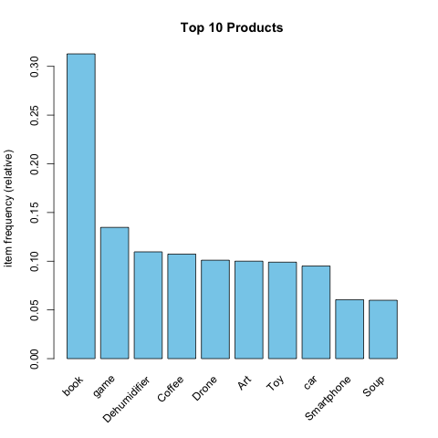
Visualizations
These are the top 10 product transactions
from the ACME Innovations.
We found these products more often in the product recommendations in the Apriori model as well.

Slide 6
Conclusion
Based on the customer segmentation, we found that there are customers who have high salary with less spending score. We can leverage them to increase the revenue of ACME Innovations. Offer Memberships to the high spending customers to increase recurring revenue of the company.
Based on the product recommendation, we found that there are products with good support and confidence scores that are likely to get bought if the customer buys a product. ACME Innovations can focus more on these and recommend to the customers and offer discounts based on their order value.
Example Recommendations:
[1] {Football, Tennis net} => {Baseball glove}
[2] {Camping chair, Soccer ball} => {Baseball glove}
[3] {Hose, Tape measure} => {Drill}
[4] {Recliner, Rug} => {Box spring}
[5] {Bar stool, Dresser} => {Coffee table}

